Slide 1
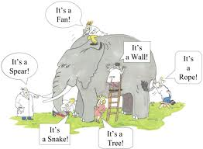
.
Christopher Bauman – www.chrisbauman.com.au

Slide 2
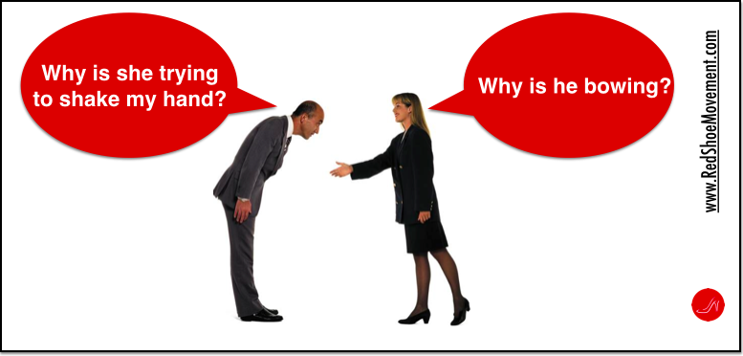
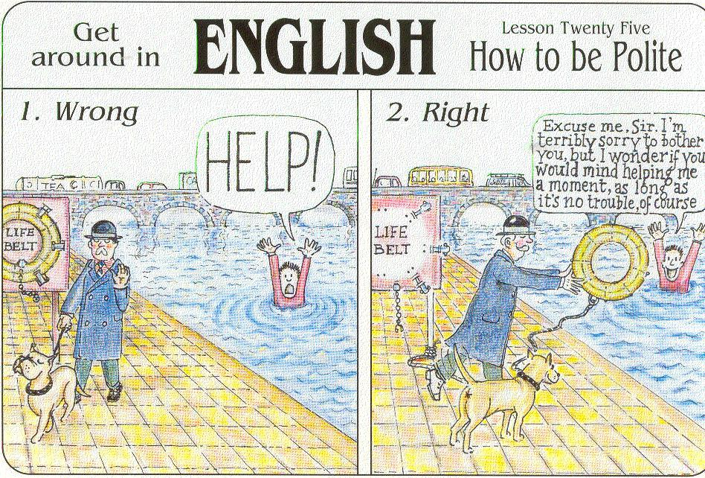
Christopher Bauman – www.chrisbauman.com.au

